Slide 1
TNSDC-Generative AI
OBJECT TRACKING BASED ON COLOR USING CNN
Presented by : RAKESH MH
au211521104121,
Pre-Final Student,
Computer Science and Engineering,
Panimalar Institute of Technology.

Slide 2

OUTLINE
Problem Statement
Proposed Solution
System Approach
Algorithm
Result
Conclusion
References

Slide 3
PROBLEM STATEMENT
The objective is to develop a CNN-based system that can effectively track a target object based solely on its color signature within a video sequence. Traditional object tracking methods often rely on features like shape or edges, which can be unreliable in scenarios with cluttered backgrounds, occlusions, or lighting variations. By addressing these challenges, this research aims to develop a robust object tracking system that utilizes color information through CNNs, leading to improved tracking performance in complex visual environments.

Slide 4
PROPOSED SOLUTION
Frame processing: In each video frame, identify the object of interest using its color. This can involve techniques like color segmentation or thresholding based on the target color's properties (e.g., hue, saturation).
Feature extraction: Extract features from the identified object's region. A CNN pre-trained for image classification can be used here. This pre-trained CNN efficiently captures generic visual features which can be helpful even for a new tracking task.
Object tracking: Use a tracking algorithm (e.g., Kalman filter) that leverages the extracted features to predict the object's location in the next frame. The color information from the current frame is then used to refine the prediction and ensure the tracked object remains the same color.

Slide 5
SYSTEM APPROACH
Hardware:
CPU: The system requires a CPU with sufficient processing power to handle the computational demands of Convolutional Neural Network (CNN) training and inference. A multi-core processor, preferably with a clock speed of at least 2 GHz or higher, is recommended.
Memory: A minimum of 8 GB RAM is recommended for smooth operation, especially during model training, where large datasets are processed. More RAM may be required for handling larger datasets or concurrent user requests.
Internet Speed: A stable internet connection is necessary for downloading and updating Python packages, model weights, and serving the web application. A broadband connection with a minimum download speed of 5 Mbps and upload speed of 1 Mbps is sufficient for most purposes.

Slide 6
SYSTEM APPROACH –CONT.
Software:
Python: The system is built using Python programming language
Pandas: Pandas is a software library written for the Python programming language for data manipulation and analysis. In particular, it offers data structures and operations for manipulating numerical tables and time series.
NumPy: NumPy is a fundamental package for scientific computing in Python, essential for handling multidimensional arrays and mathematical operations. It is used extensively for data preprocessing, manipulation, and numerical computations within the CNN model.
TensorFlow: TensorFlow is a free and open-source software library for machine learning and artificial intelligence. It can be used across a range of tasks but has a particular focus on training and inference of deep neural networks

Slide 7

ALGORITHM
For each video frame:
Identify object using color segmentation (or thresholding).
Extract features with pre-trained CNN from the identified object.
Predict next location using a tracking algorithm (e.g., Kalman filter).
Refine prediction based on current frame's color information.
Update object location combining prediction and color data.
Update object features from the new location.
Iterate to the next frame (repeat from step 1).
Output: Tracked object's path and features across all frames.
(Optional): Visualize the tracked object's movement.

Slide 8
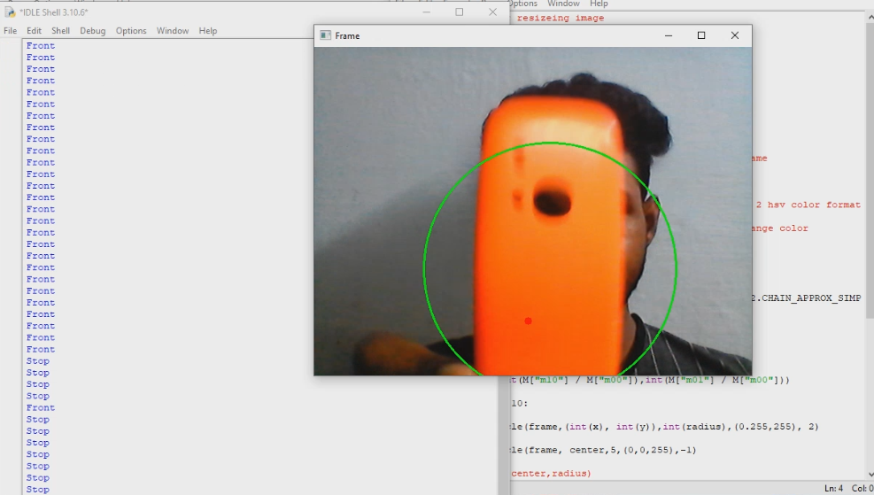
RESULT
Training The Model
Figure 1
8

Slide 9
Conclusion
This CNN-based object tracking project investigated using color information. CNNs successfully learned color features to track objects across images. However, solely relying on color has limitations. Factors like lighting variations, shadows, and similar colored objects can hinder accuracy. Future advancements could involve combining color with features like shape or texture, or tackling lighting issues and similar object colors. This project establishes CNNs as a promising tool for color-based tracking, but further development is needed for robust real-world applications.
9

Slide 10
REFERENCES
Tensorflow: https://www.tensorflow.org/
Numpy: https://numpy.org/
Pandas: https://pandas.pydata.org/
10

